Slide 1

Unicorn Growth
Athena Wu
Ian Nguyen
Lana Huyen
Oty Baasandorj

Slide 2

Overview:
A PRIVATELY HELD STARTUP WITH VALUATION ABOVE 1 BILLION USD
Using the data of each unicorn company between 2022 and 2024, we will look at:
The relationship between growth and: industry, year inducted as a Unicorn company, and location
Visualizations of data
Analysis

Slide 3
INDUDSTRY : 2022 GROWTH
Artificial Intelligence experienced the highest average growth rate, while the E-commerce & Direct-to-Consumer and Edtech industries saw significant declines.

Slide 4
INDUDSTRY : 2023 GROWTH
Data Management & Analytics and Artificial Intelligence industries had notable growth, whereas the Internet and Supply Chain, Logistics, & Delivery industries experienced a decrease

Slide 5
INDUDSTRY : TOTAL GROWTH
Artificial Intelligence and Other industries demonstrated the most substantial average total growth, highlighting their strong performance over the period, while the E-commerce & Direct-to-Consumer and Edtech industries underperformed

Slide 6
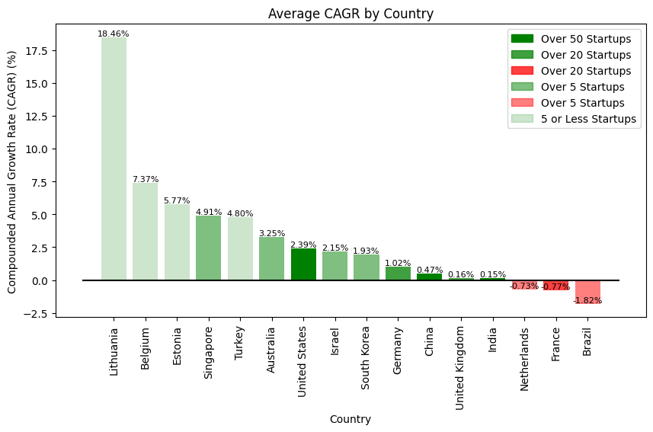
Compounded Annual Growth Rate (CAGR) is the average annual growth rate over the past two years (2022 to 2023 and 2023 to 2024).
Average CAGR by Country
Lithuania leads with an average CAGR of 18.46%.
Focus on external markets
Collaborate ecosystem
Top three countries in terms of avg. CAGR are European
A potential greater growth trajectory in Europe in terms of the global startup ecosystem
U.S. and China lead in the number of unicorn startups but exhibit lower growth rates.
Suggests that a larger volume of unicorn startups may impede overall growth due to greater competition, market saturation, and a focus on internal markets

Slide 7
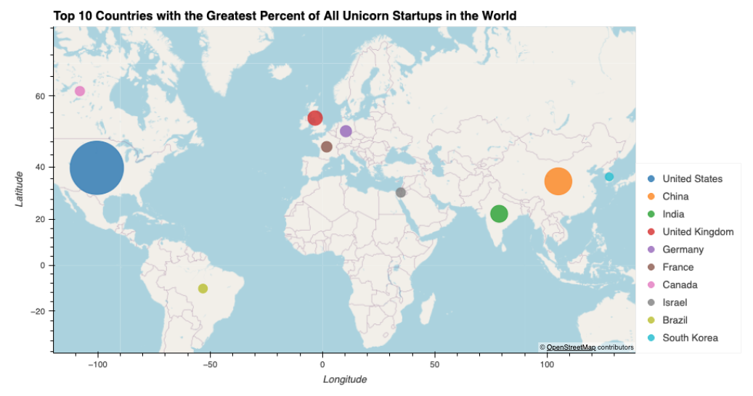


Map Visualizations by Country

Slide 8
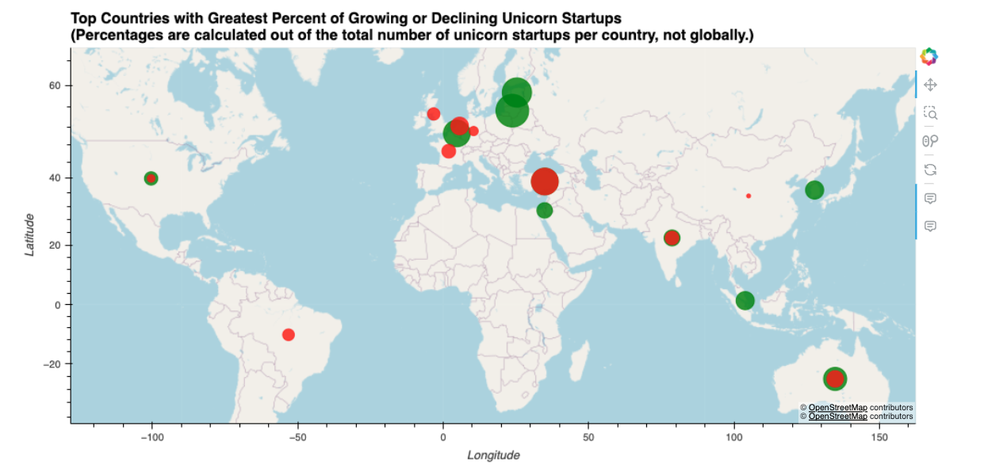
MAP VISUALIZATIONS BY COUNTRY

Slide 9
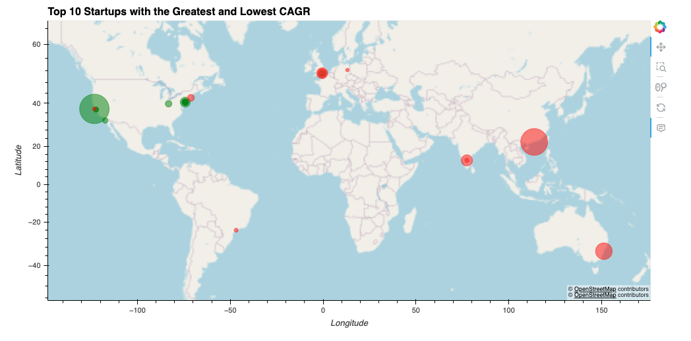
MAP VISUALIZATIONS BY STARTUP

Slide 10
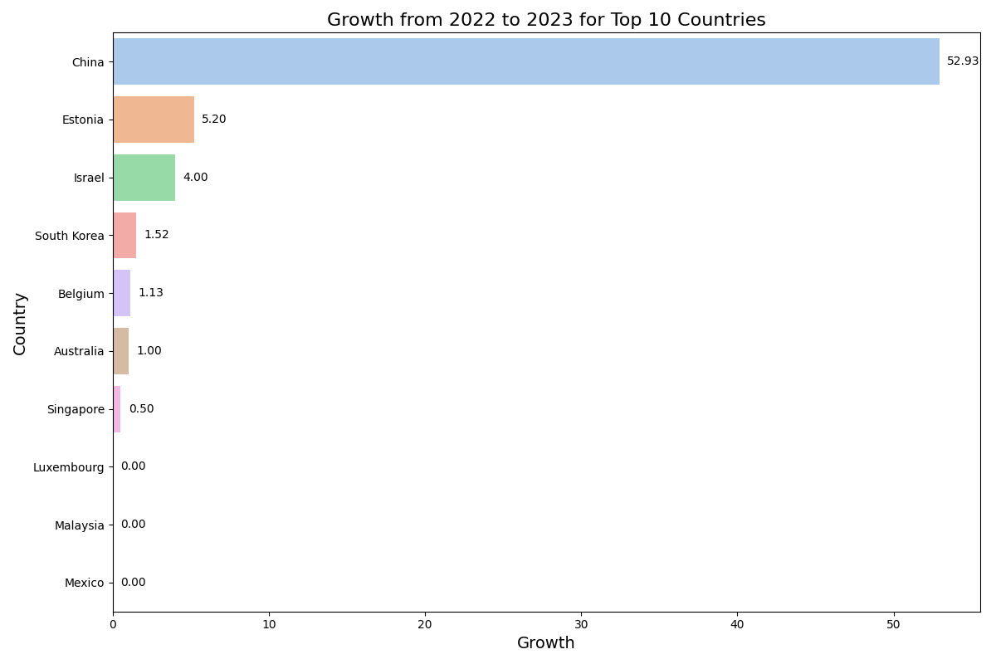
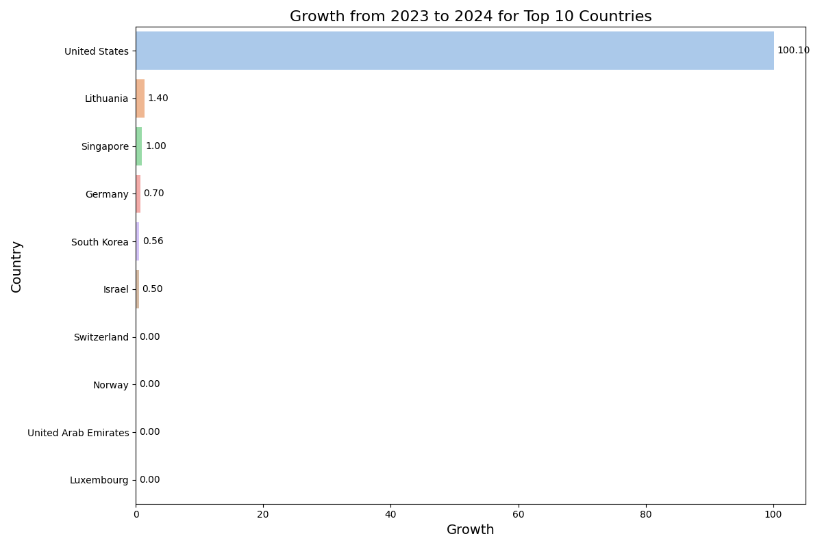
China had the highest growth from 2022 to 2023 with a growth of $52.93 Billion across all industries.
Whereas from 2023 to 2024, the United States experienced a growth of $100.10 Billion.

Slide 11
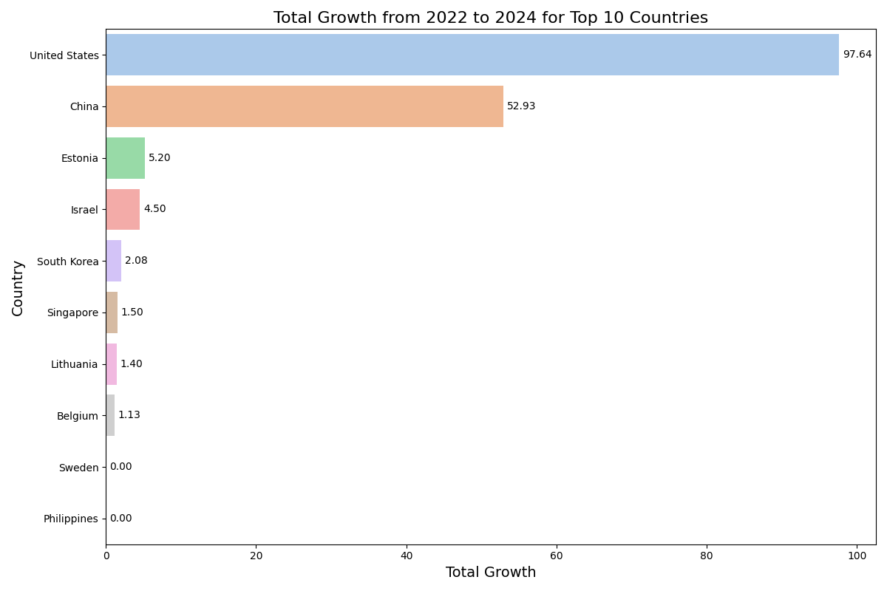

Slide 12
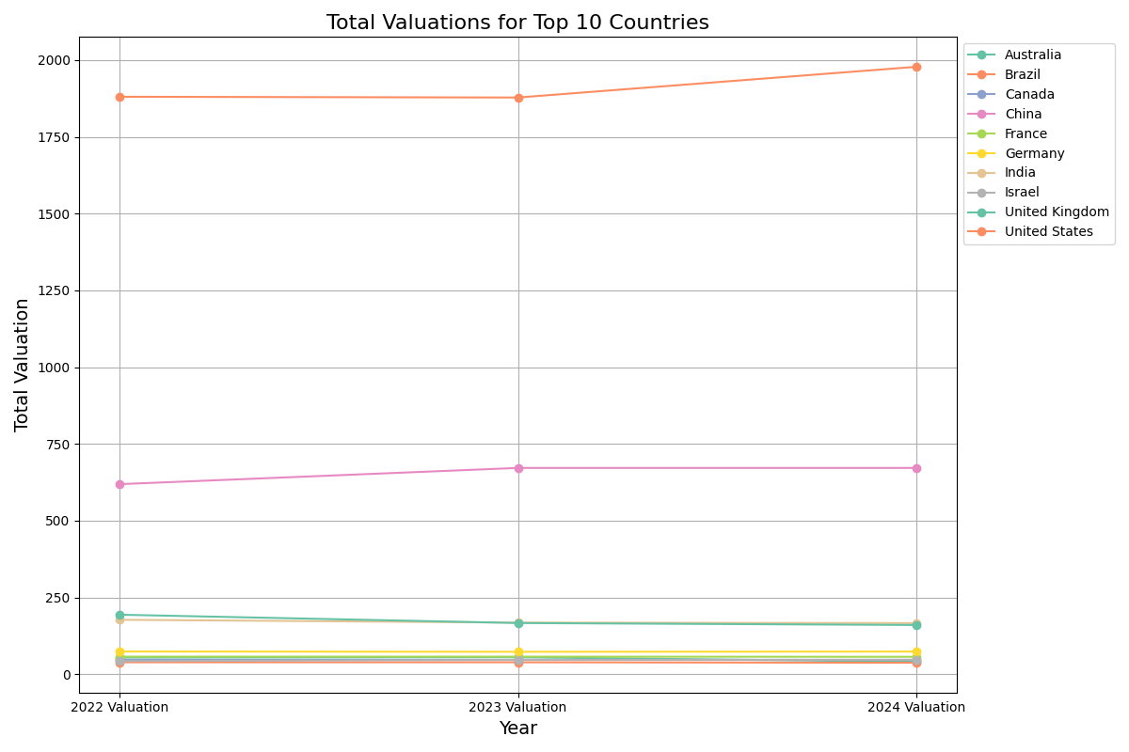
The United States and China are leading the world in their total valuation of all companies in their countries.

Slide 13
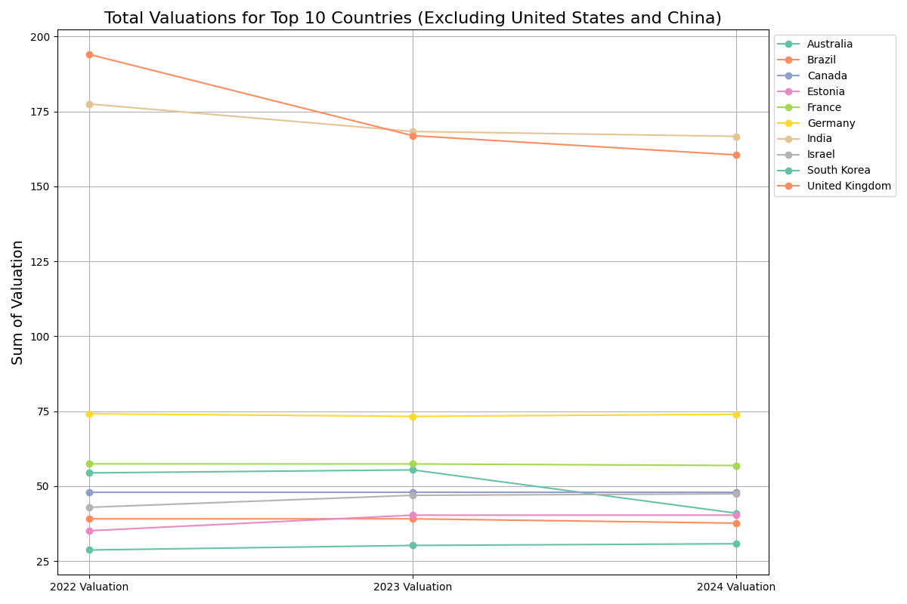

Slide 14
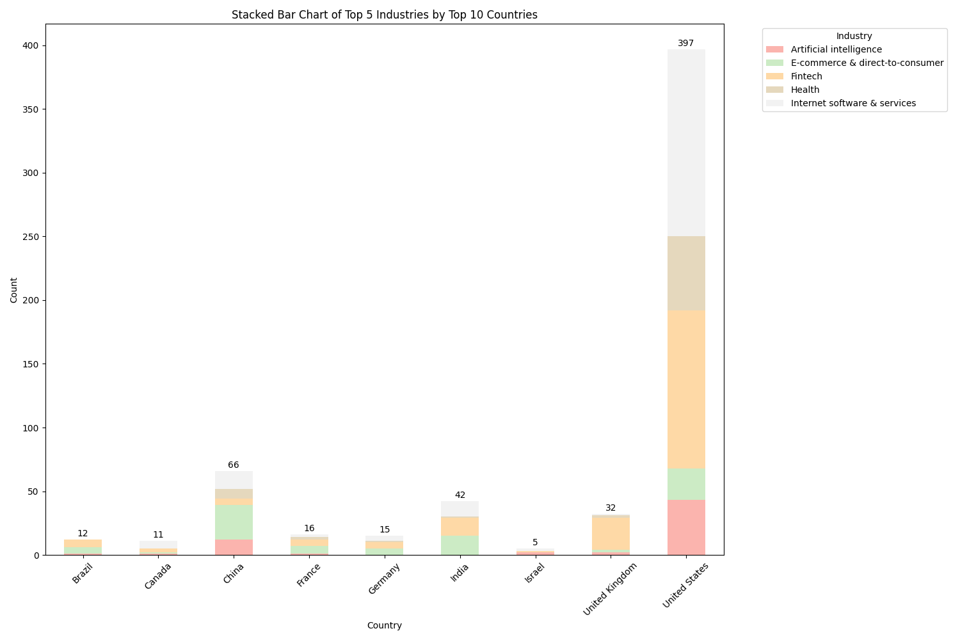
The United States is also leading in the number of unicorn companies at 397 as China is next with 66 companies.

Slide 15
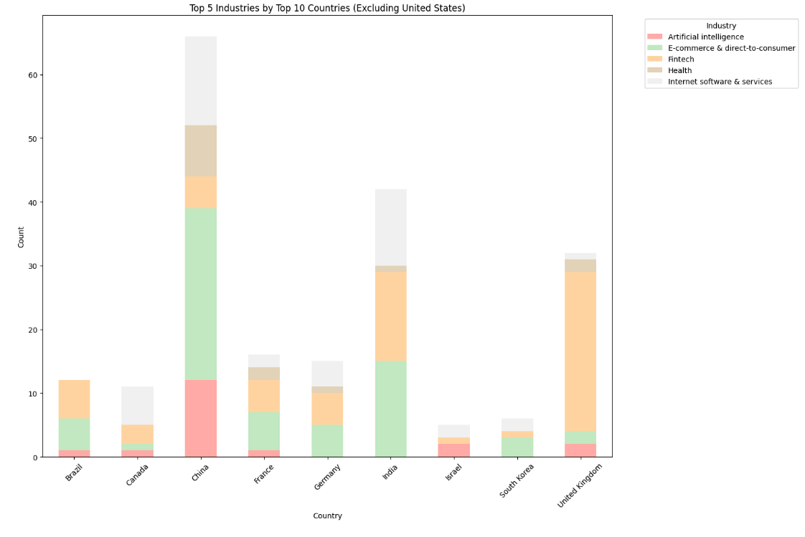

Slide 16
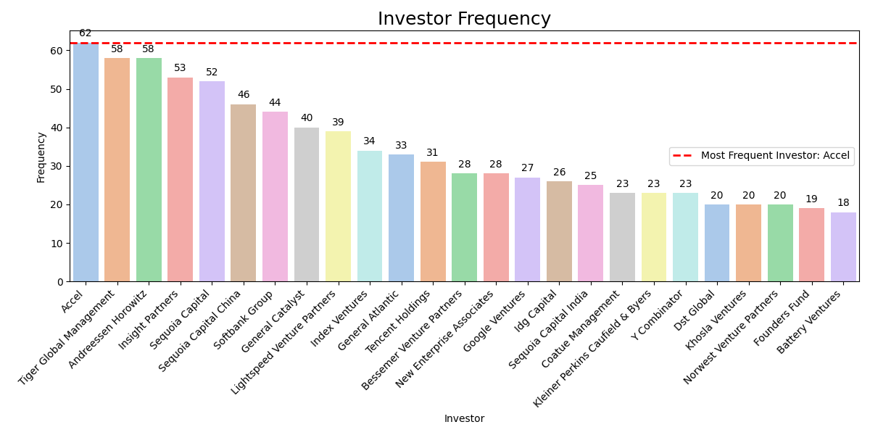
From a total of 1189 select investors, Accel has invested the most, in 62 companies. Accel has invested mainly in internet software & services. Other industries include cybersecurity, artificial intelligence, health, hardware, and more.

Slide 17
Comparing the Entry Dates of Unicorn Companies
What does “date joined” entail?
Typically means the date when the company reached a market valuation of $1 billion or more, officially making it a "unicorn“

Slide 18
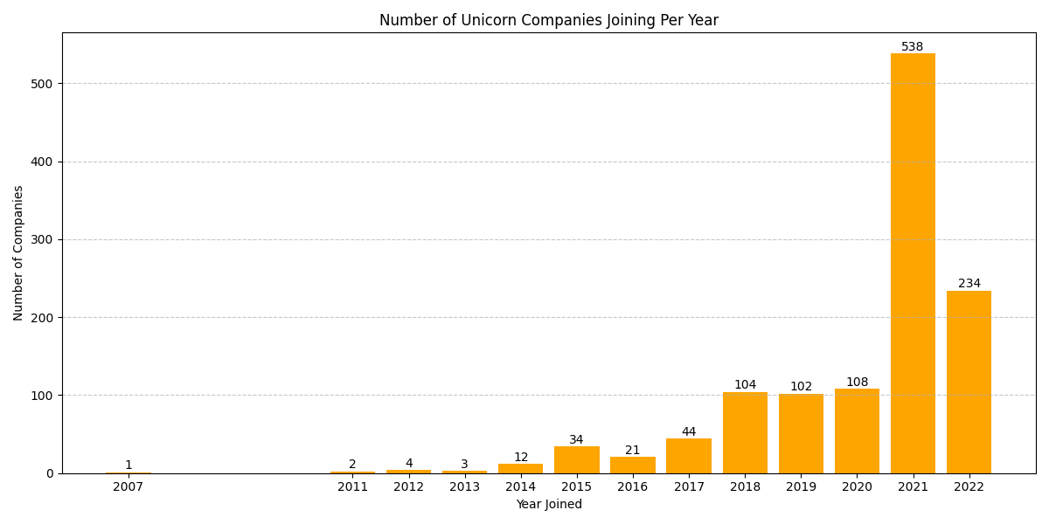
There is a significant Increase in Unicorn Companies in 2021. Possibly due to accelerated digital transformation and increased adoption of technology driven by the COVID-19 pandemic.

Slide 19
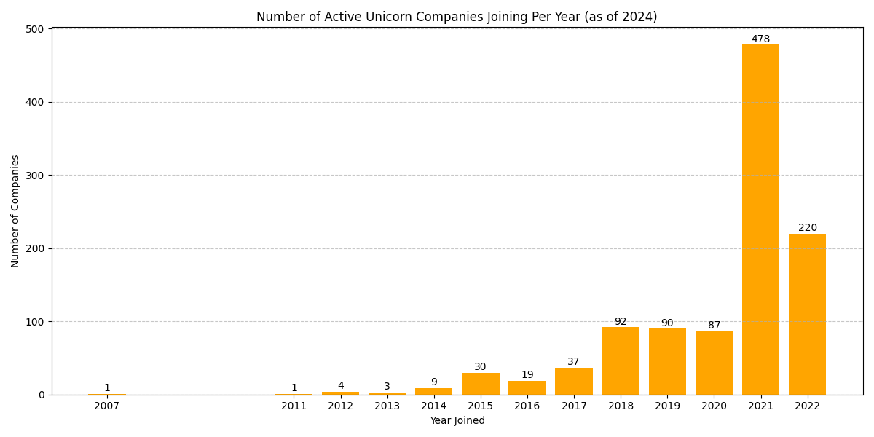
As years went on, there were a notable 136 start up companies that no longer had a market value of $1B or more. 2021 still greatly holds the highest quantity of Unicorn companies founded.

Slide 20
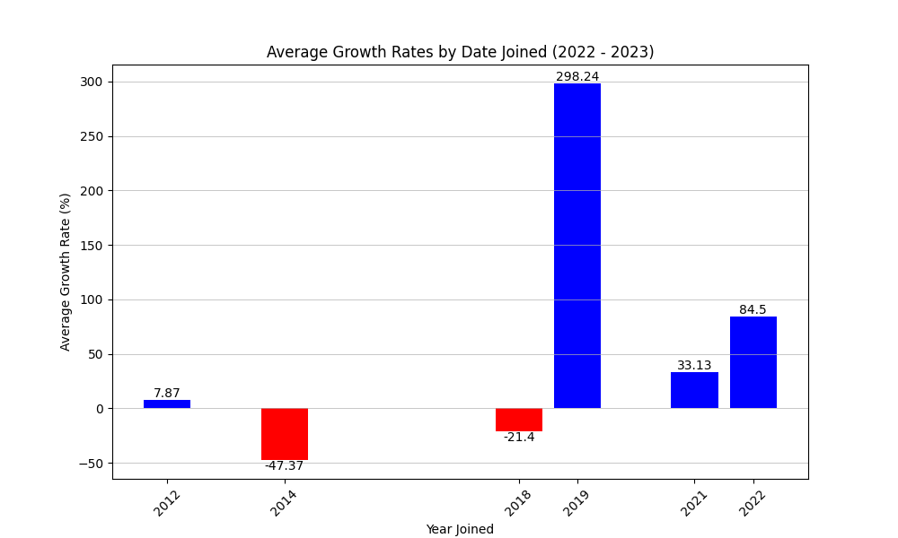
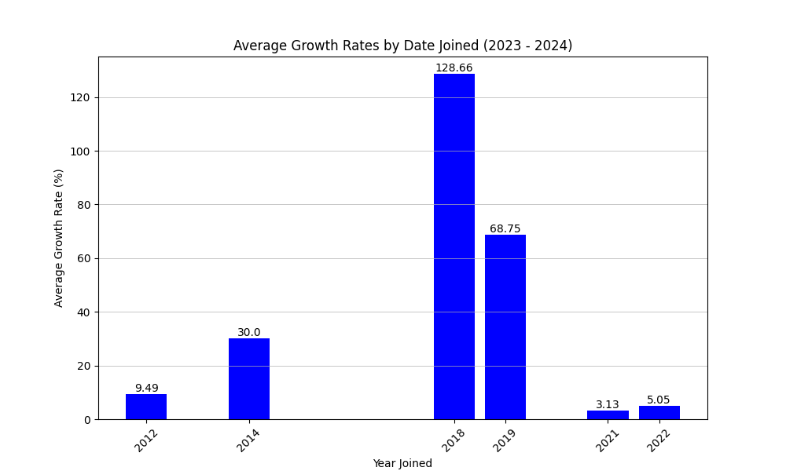
Average Growth Rates

Slide 21
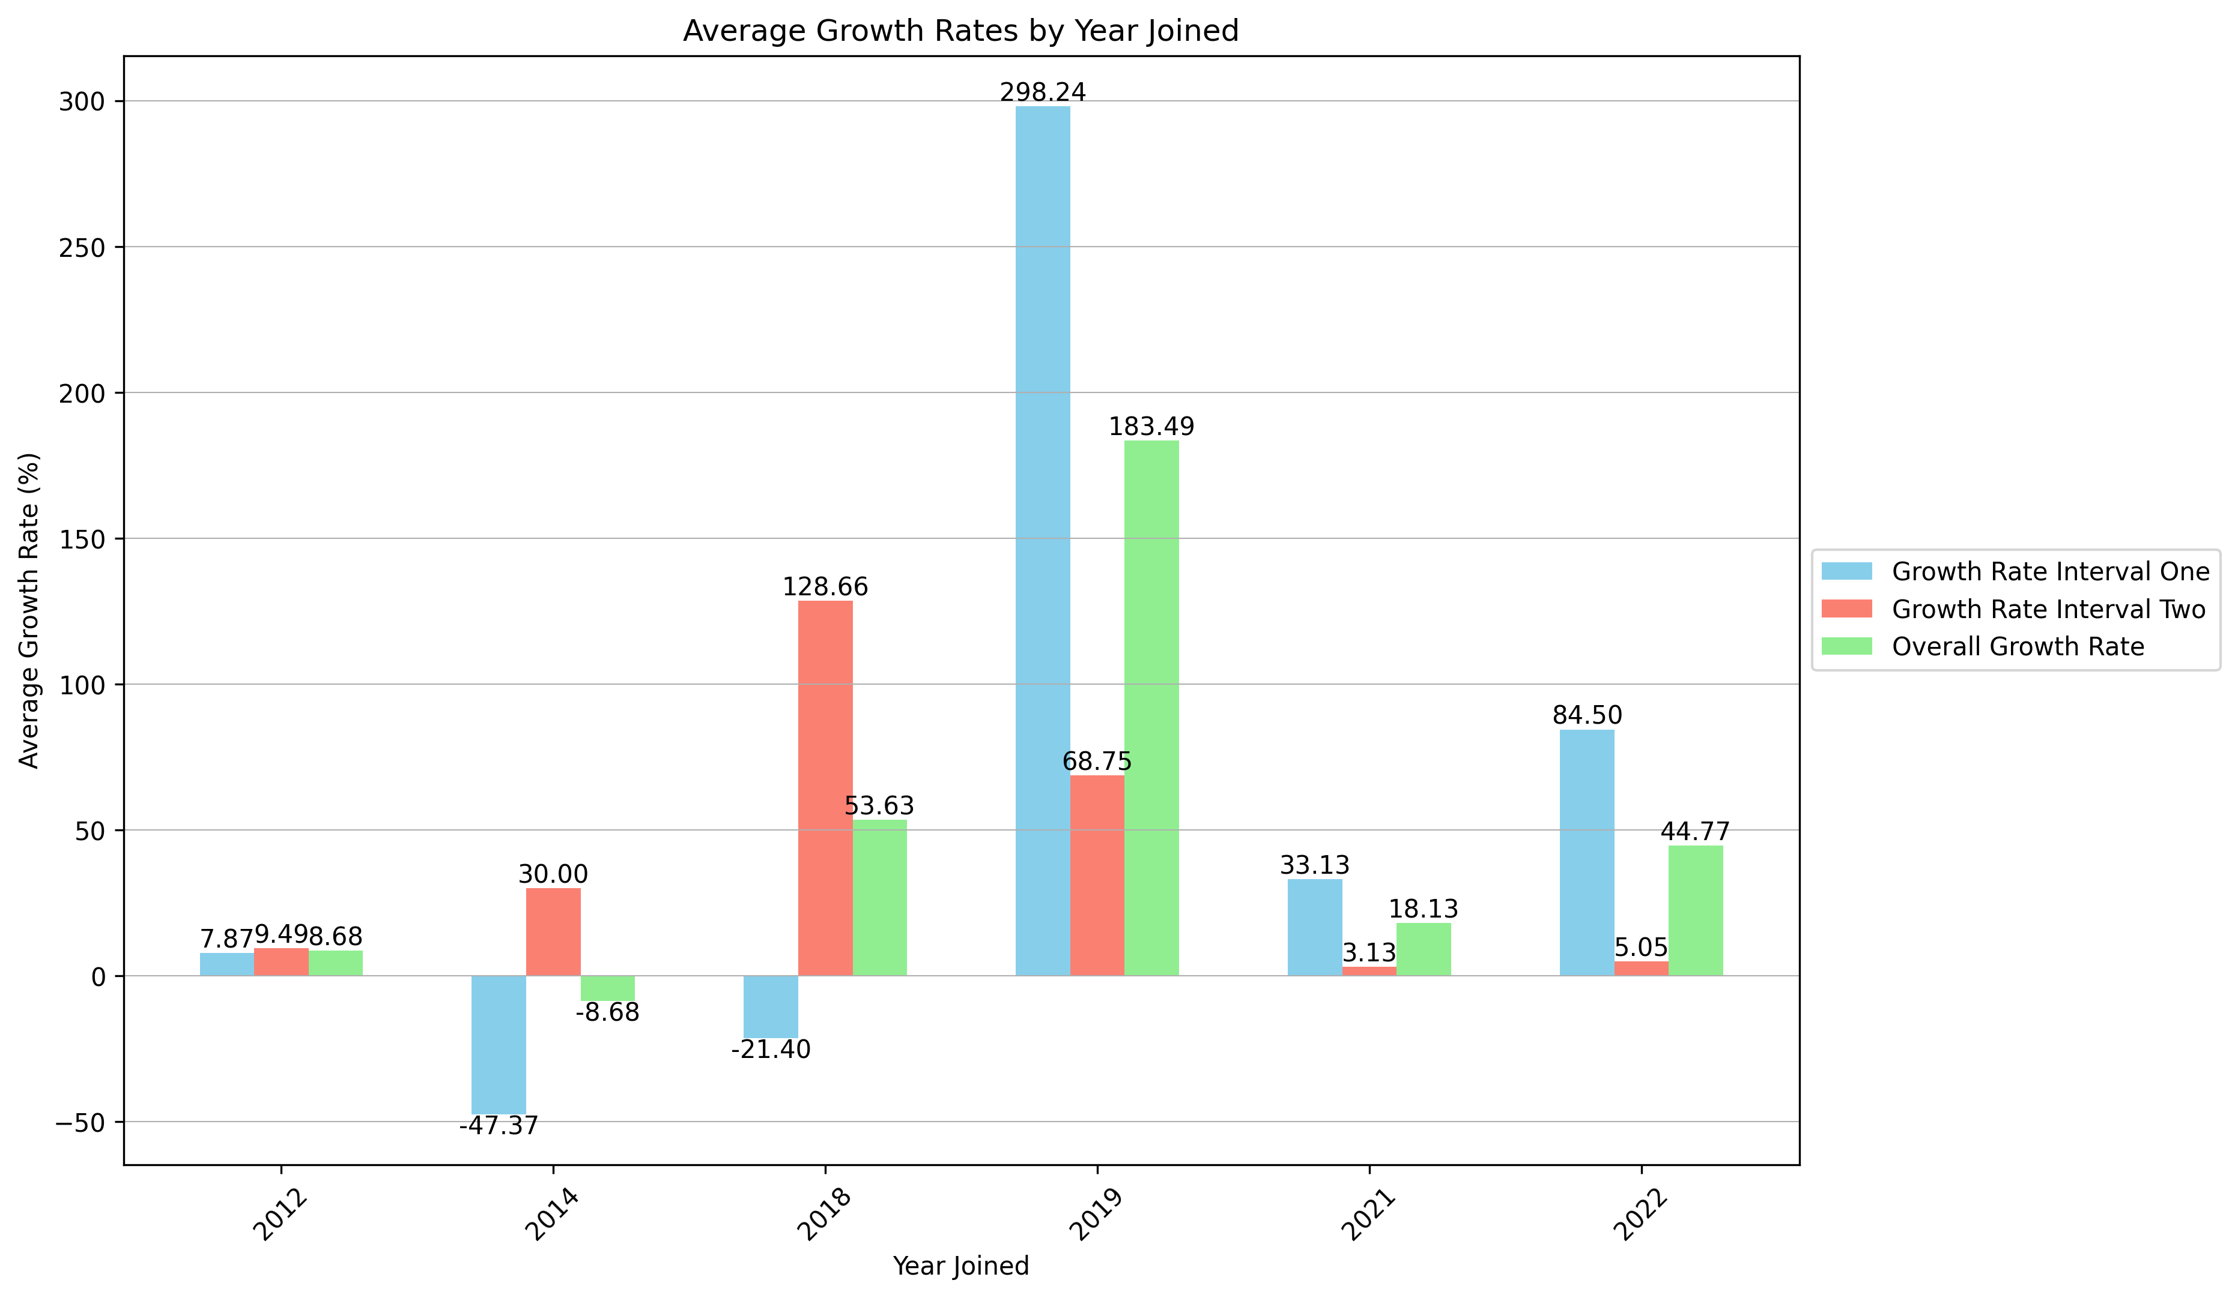

Slide 22
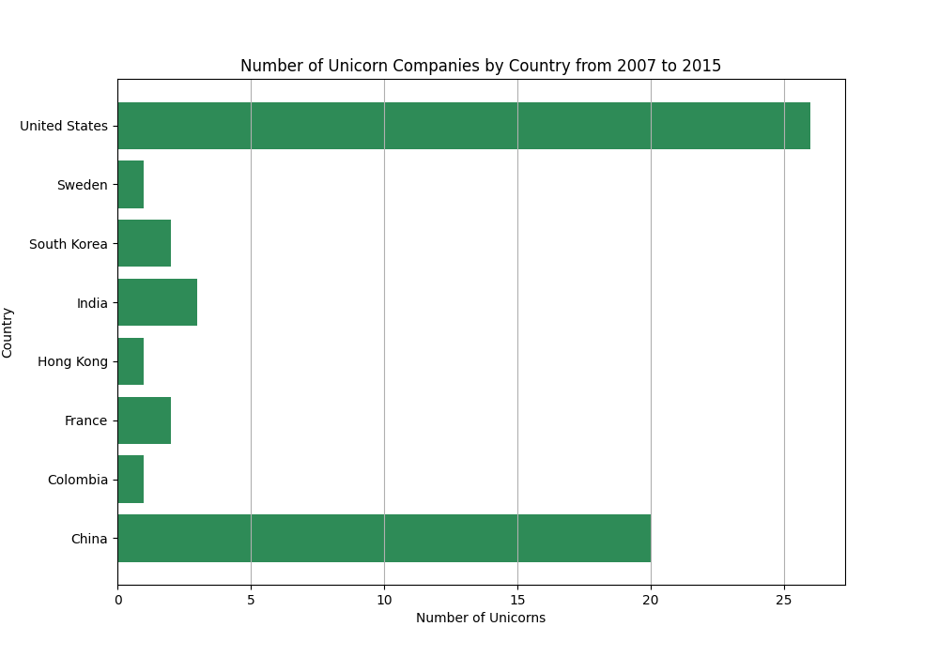

Slide 23
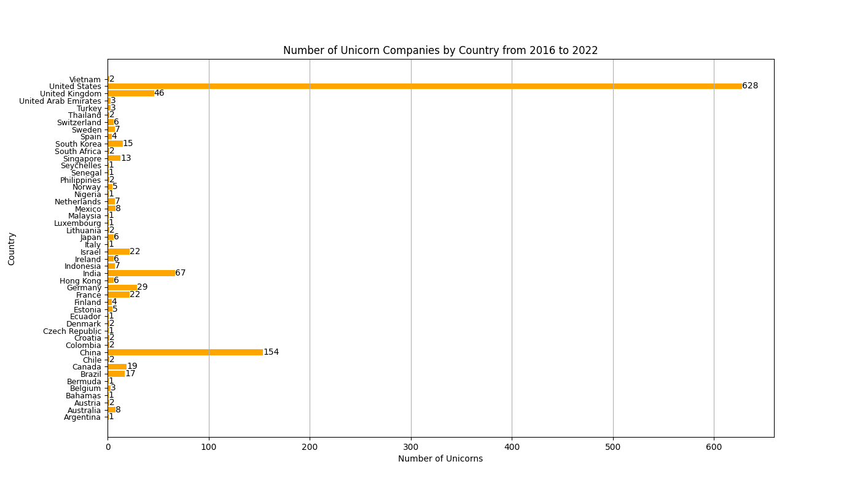
Important observation that there are a lot more active Unicorn Companies that were founded between the years 2016-2022

Slide 24
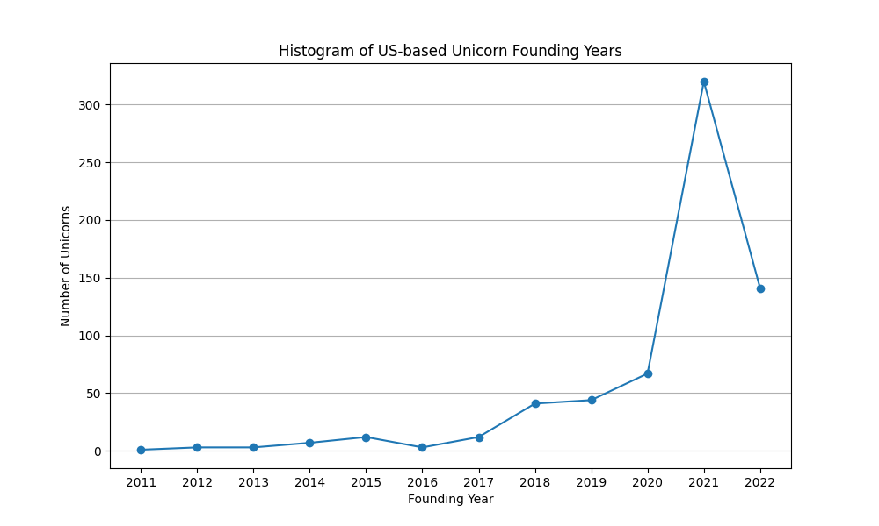
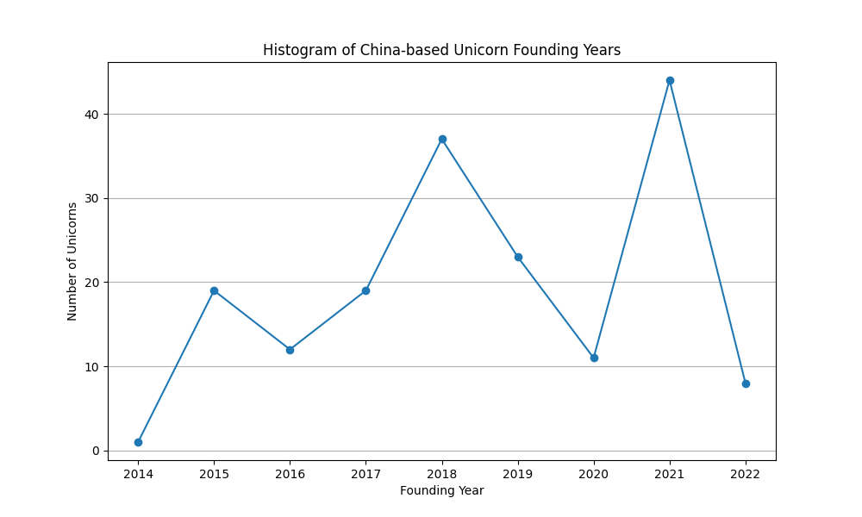
US vs China Unicorn Growth

Slide 25
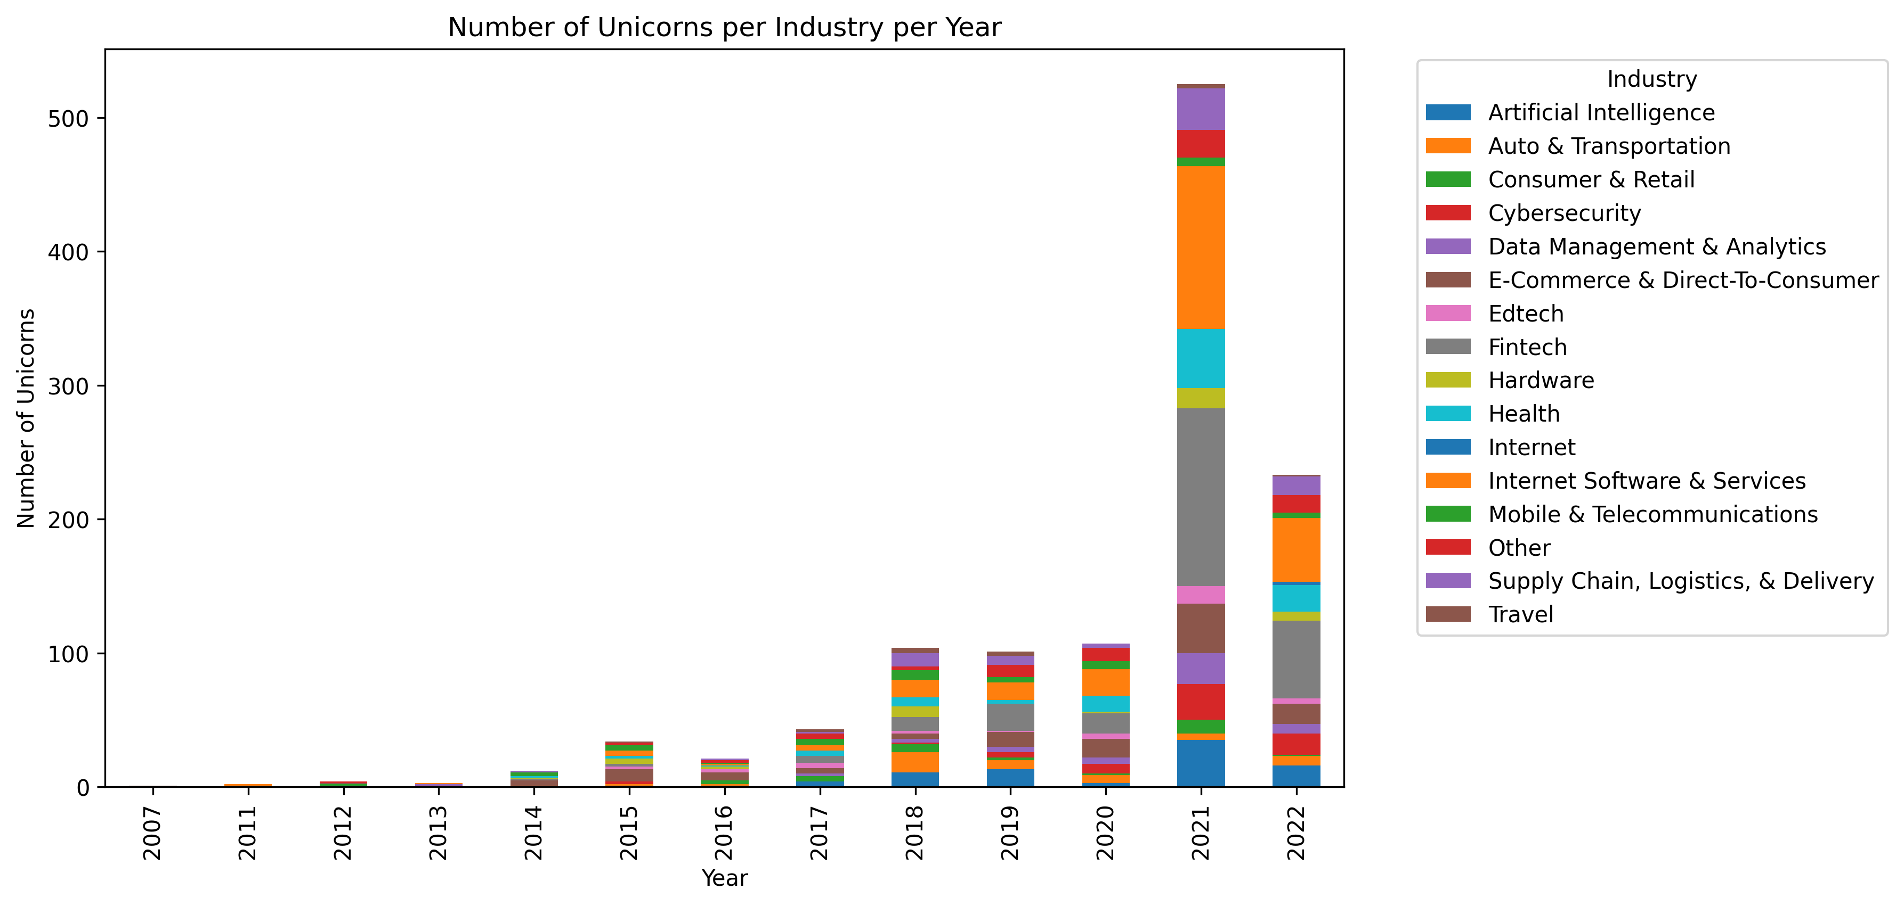
Fintech is the most consistent industry throughout the years to join Unicorn Company status

Slide 26
Valuation Trends:
Significant growth is observed in companies within the Artificial Intelligence and Other industries from 2022 to 2024, while industries like E-commerce & Direct-to-Consumer and Edtech have shown notable declines over the same period.
Geographic Distribution:
The dataset includes companies from diverse geographic locations, with a significant presence in the United States and China. Notable cities with high valuation companies include San Francisco, Beijing, and Shenzhen.
Date of Joining:
A noticeable trend is the influx of high-valuation companies joining around the years 2017 and 2018, indicating a peak period for startup formations and investments.
Industry Distribution:
The dataset is well-represented across various industries, with a strong emphasis on emerging sectors such as Artificial Intelligence, Data Management & Analytics, and Internet Software & Services, indicating a focus on technology-driven growth.
Investor Influence:
Prominent investors like Sequoia Capital, Tiger Global Management, and Andreessen Horowitz are recurrently mentioned, highlighting their significant role in funding and supporting high-valuation startups across multiple industries.

Slide 27
Data Set Sources:
CB Insights:
- https://www.cbinsights.com/research-unicorn-companies
Kaggle:
- https://www.kaggle.com/datasets/tahzeer/unicorn-startup-companies-july-2023
- https://www.kaggle.com/datasets/ramjasmaurya/unicorn-startups
sources

